Slide 1

Exam AZ-304: Microsoft Azure Architect Design Crash Course
Tim Warner

Slide 2
Day 2 of 2 Agenda
Content catch-up
Logic Apps, AVD
Monitoring
Identity and security design (25-30%)
Data storage design (15-20%)
Exam AZ-304 strategy

Slide 3
Course Materials
timw.info/az304

Slide 4

Session Recordings

Slide 5

Tim's "Tower Bridge" Certification Study Model

Slide 6

Thank you!
Course materials: timw.info/az304
Twitter: @TechTrainerTim
Work: timw.info/ps
Web: TechTrainerTim.com

Slide 7
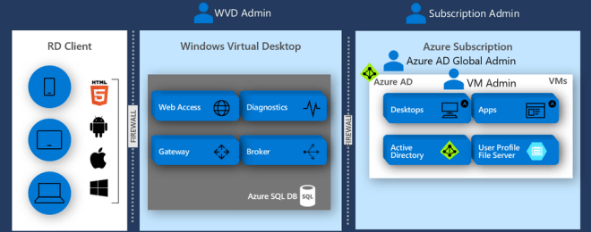
Azure Virtual Desktop (AVD)
timw.info/travis

Slide 8
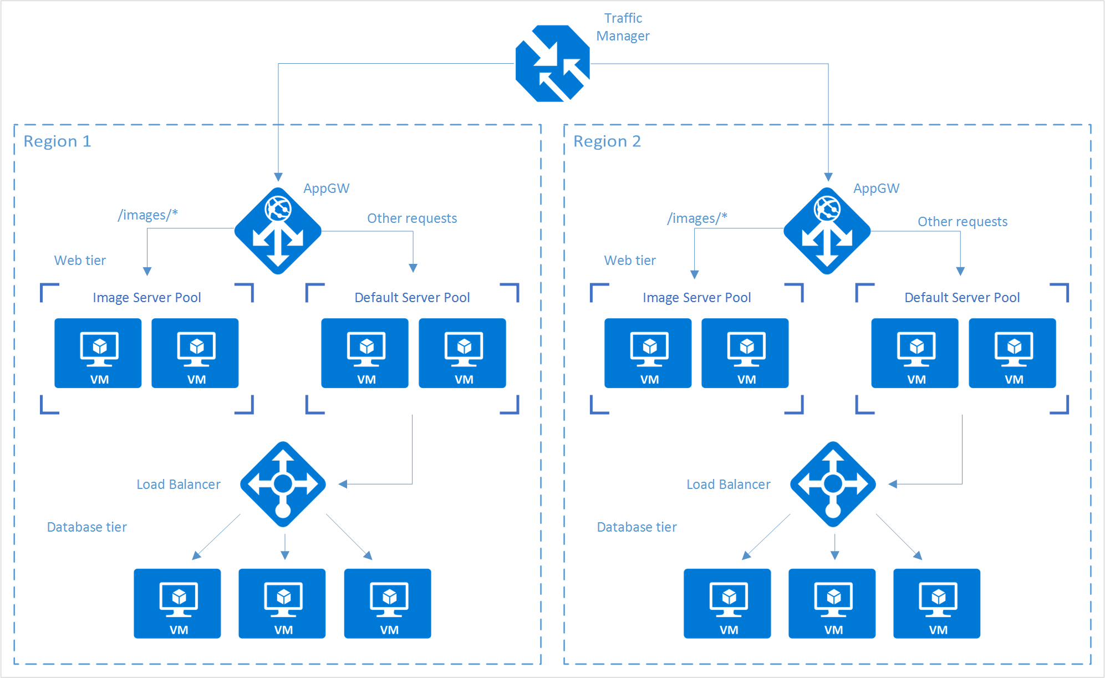
Load Balancing

Slide 9
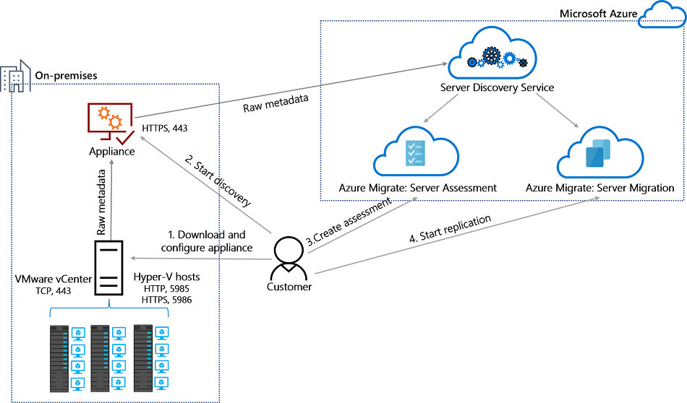
Azure Migrate

Slide 10

Azure Monitor

Slide 11

Log Analytics

Slide 12

Tenant vs. Subscription

Slide 13

Hybrid Identity

Slide 14

Azure AD B2C

Slide 15
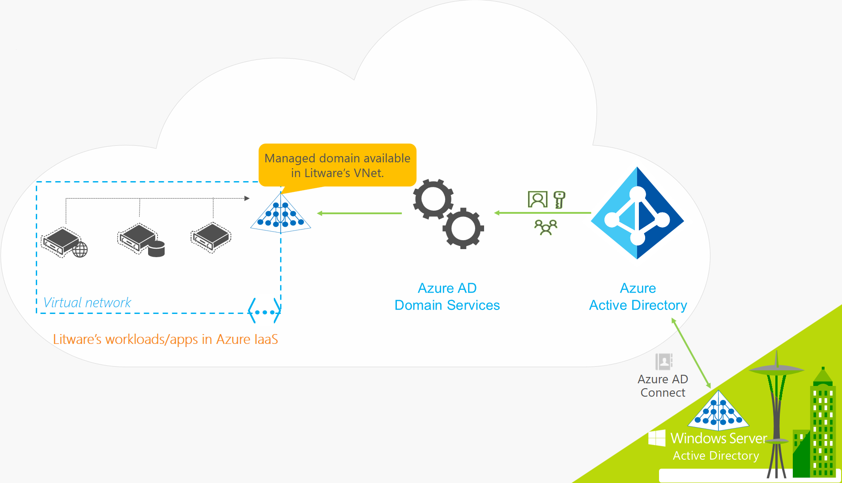
Azure AD Domain Services

Slide 16
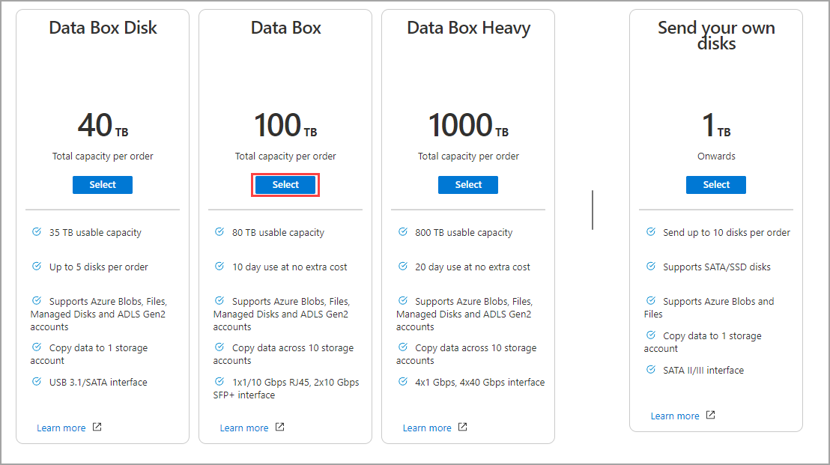
Azure Data Box

Slide 17

Pass-through Authentication

Slide 18

Seamless Single Sign-on

Slide 19

Azure Management Scopes
/ Tenant Root

Slide 20

VM Scale Sets

Slide 21

Availability Set

Slide 22

Availability Zone

Slide 23


Docker Container Lifecycle
https://timw.info/3635f

Slide 24
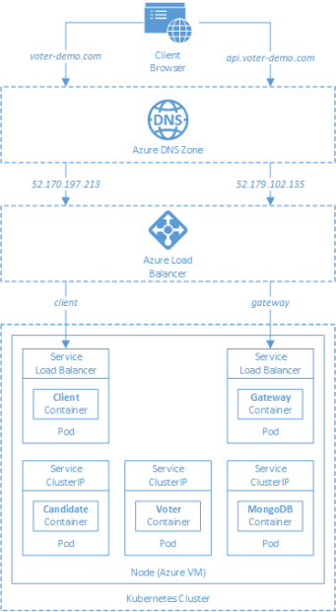
AKS

Slide 25

Data Pipelines

Slide 26
Storage Account Replication
1
3
3
2
LRS
ZRS

Slide 27
Storage Account Replication
3
3
GRS/RA-GRS

Slide 28
Storage Account Replication
1
3
1
3
2
2
GZRS – RA/GZRS

Slide 29

Always Encrypted

Slide 30
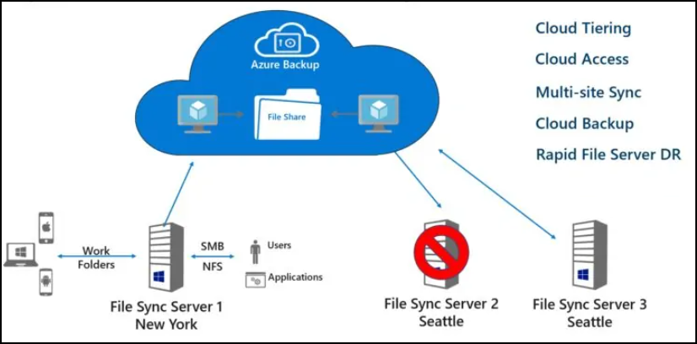
Azure File Sync

Slide 31
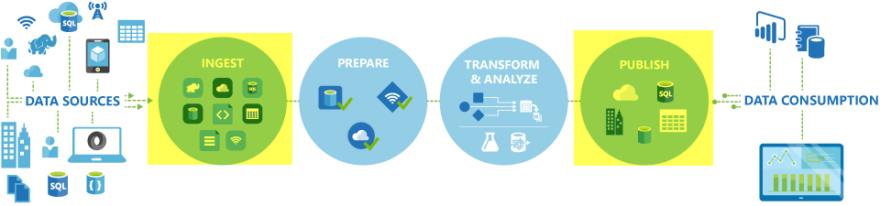
Azure Data Factory

Slide 32

Event Architecture

Slide 33

Event Architecture

Slide 34
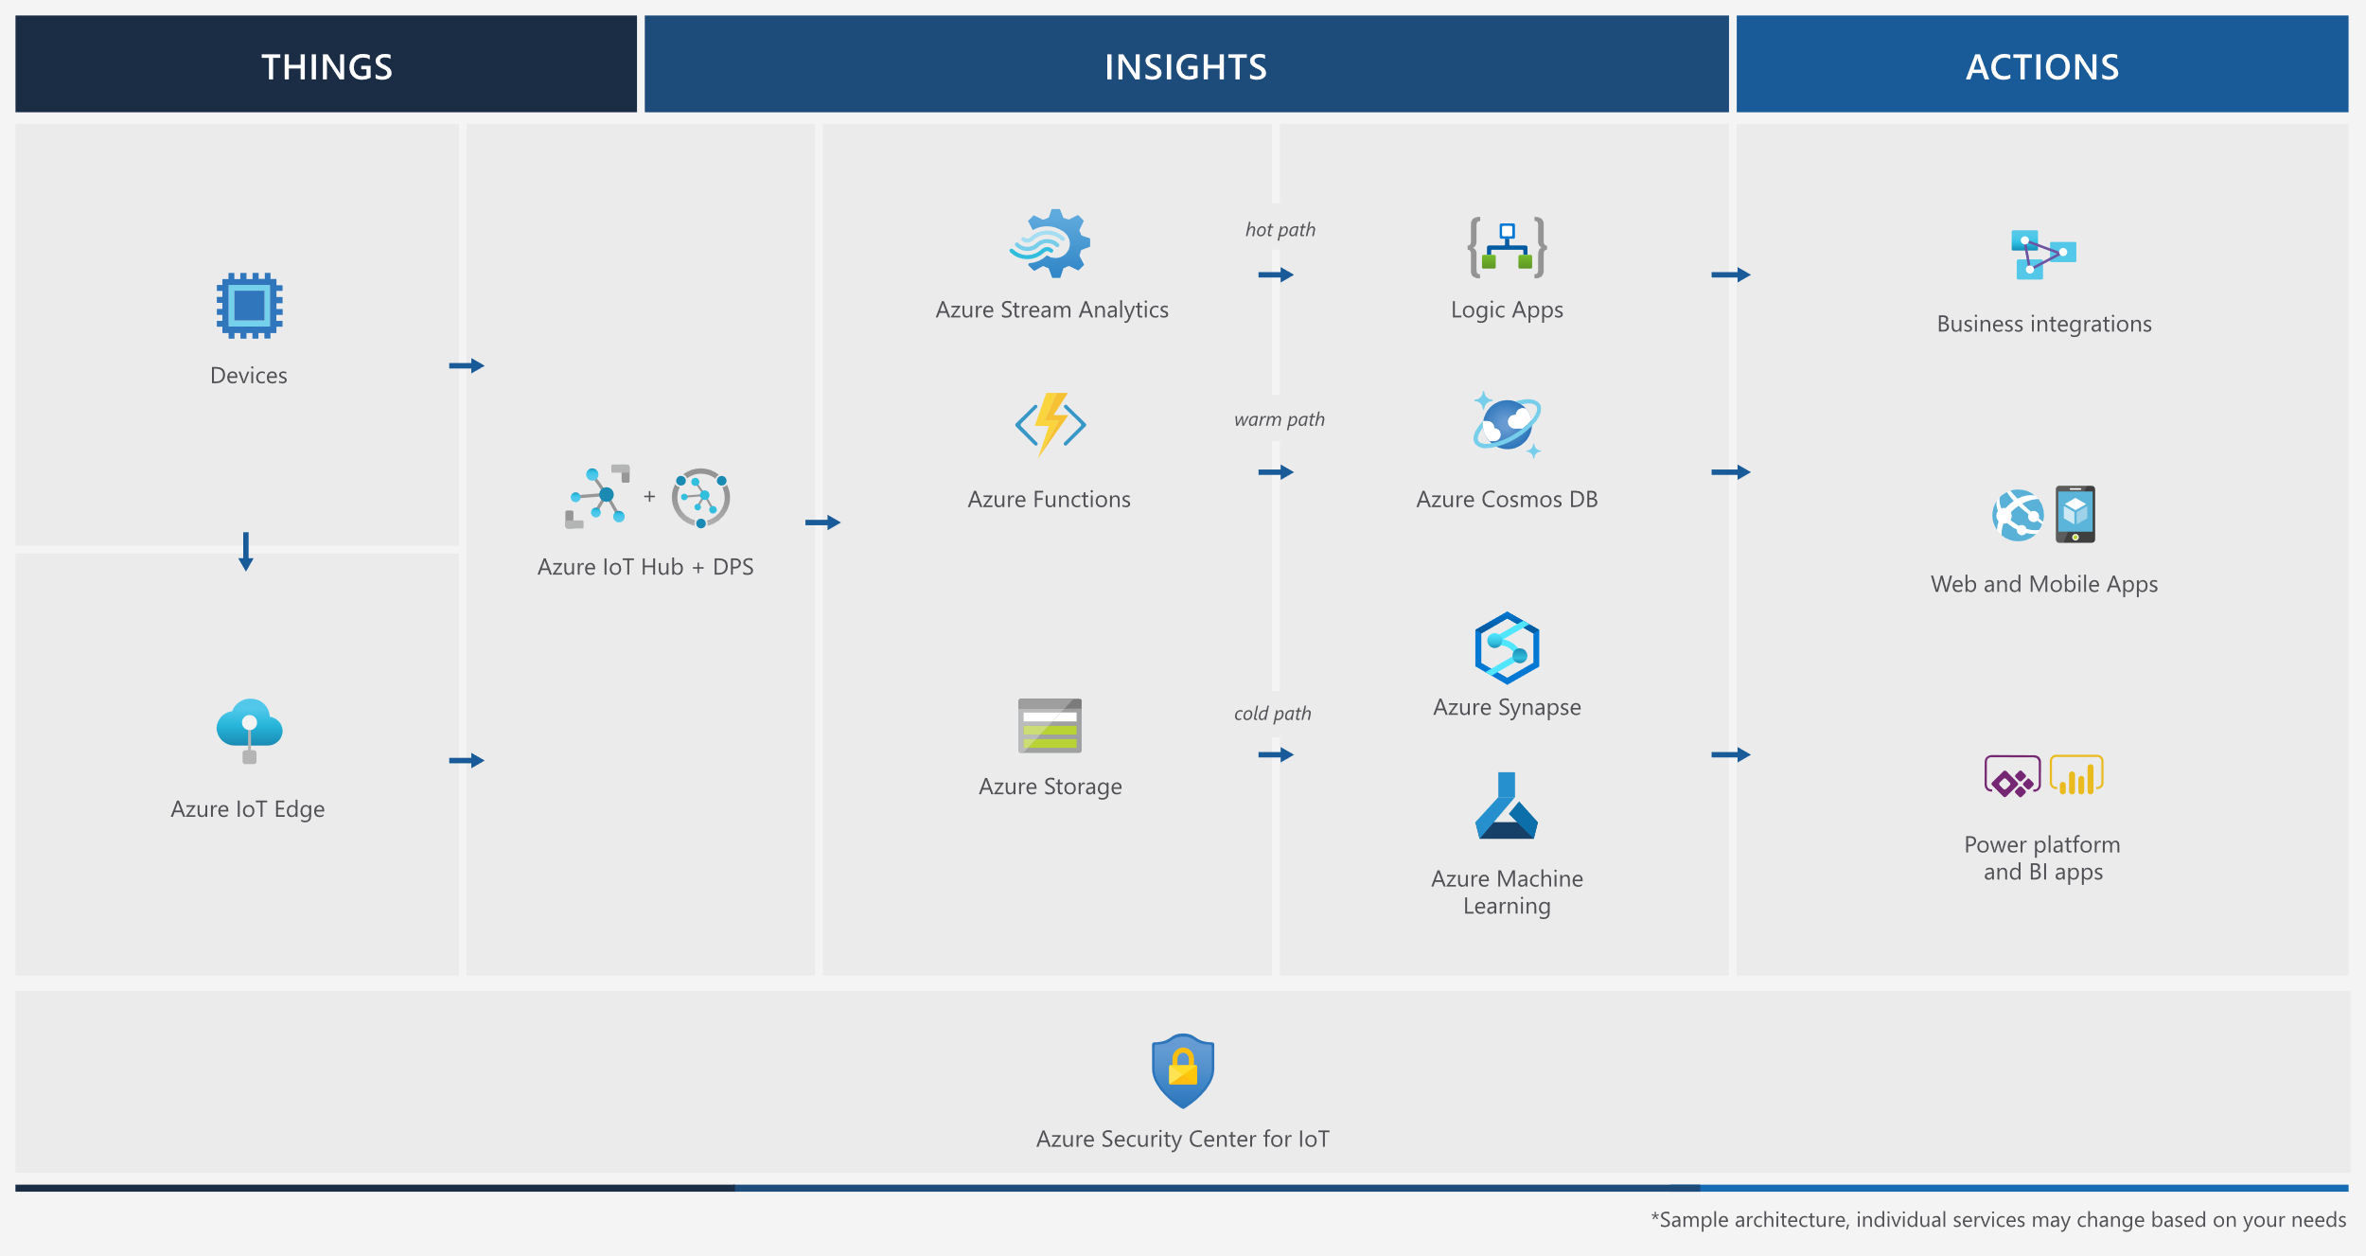
Event Architecture

Slide 35
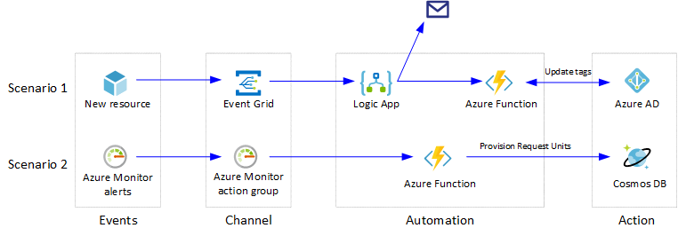
Event Architecture

Slide 36
Exam AZ-304 Item Types

Slide 37

Multiple Choice

Slide 38
Repeated Scenario
You need to move an Azure VM to another hardware host.
Solution: You redeploy the VM.
Does this solution meet the goal?
Yes
No

Slide 39

Select and Place

Slide 40

Build List and Reorder

Slide 41

Active Screen/Fill in the Blank

Slide 42

Case Study

Slide 43






Performance-Based Lab

Slide 44
Microsoft Online Testing

Slide 45
Microsoft Online Testing Process
timw.info/online

Slide 46

Microsoft Online Testing Process

Slide 47

Microsoft Online Testing Process

Slide 48

Microsoft Online Testing Process

Slide 49

Microsoft Online Testing Process

Slide 50

Microsoft Online Testing Process

Slide 51

Microsoft Online Testing Process

Slide 52

Microsoft Online Testing Process

Slide 53
AZ-304 Exam Strategy
Focus your skills accordingly:
60 percent Azure portal
20 percent Azure PowerShell
10 percent Azure CLI
10 percent KQL
Expect performance-based labs, but be thankful if you don't see 'em

